Slide 1
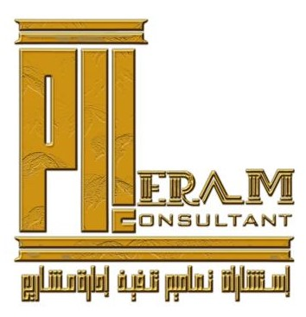
EXPERIENCE,PRECISION & EXCELLENCE

Slide 2
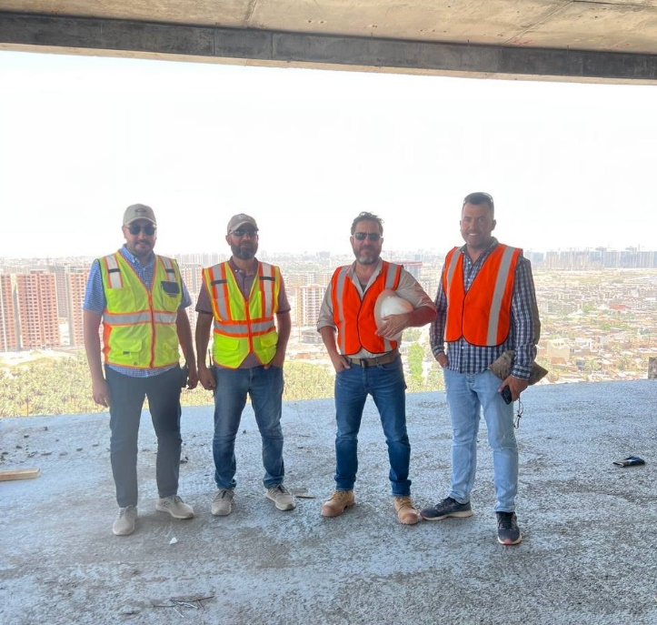
We Believe
“Our roots are important to us as we evolve and grow, we understand that maintaining the integrity of our past through a commitment to quality service, employees appreciation, and delivering innovative, practical solutions to our clients is the key to our success.”
نؤمن بأن
"إن جذورنا مهمة بالنسبة لنا ونحن نتطور وننمو، ونحن ندرك أن الحفاظ على سلامة ماضينا من خلال الالتزام بجودة الخدمة، وتقدير الموظفين، وتقديم حلول مبتكرة وعملية لعملائنا هو مفتاح نجاحنا."
EXPERIENCE,PRECISION & EXCELLENCE
الخبــــــــرة والدقــــــة والتميــــــز
1
www.eramconsultant.com

Slide 3
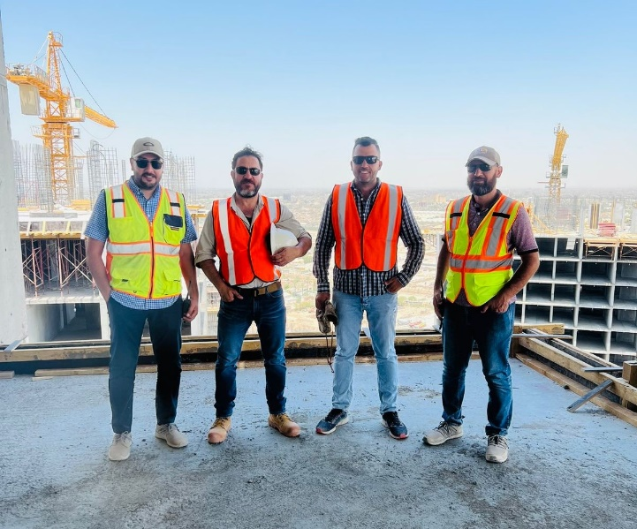
About US
ERAM Consultant is a registered Bureau in the Iraqi Engineering Union, The Head office is located in Baghdad , with another branch in Erbil, So we can deliver a more convenient service to our clients across the Iraq.
ERAM’s employs professional staff who will certainly assist you from the design and planning stage until the successful implementation.
Our team is equipped with the latest machinery, equipment, tools materials and most of all skilled and dedicated workers.
ERAM is a major item in Electro-mechanical fields has a good C.V for Supplies and Projects as well as in Civil & Construction Engineering.
Our Primary purpose is to complete the designing, supply, install, service and upgrade chains in the Construction & Electro - Mechanical fields. With our staff experience and technical know.
-MAINTENANCE -TRADING
-MANUFACTURING -CONTRACTING
-DEVELOPMENT -SERVICES
2
www.eramconsultant.com

Slide 4
CORE VALUES
Our core values recognize that our business success is founded upon our commitment to certain
principles.
- INTEGRITY
We succeed by doing things the right way, with respect to ethics, laws, quality standards
and each other.
- CLIENTS
We succeed by making our clients successful. We embrace our client’s challenges and
opportunities and work for their success.
- EXCELLENCE
We earn and advance our reputation by delivering superior value on every project that we
undertake.
- SAFETY
Whether in an office or on a construction site, keeping our people safe is our most
important measure of success.
- GROWTH
We recognize that our financial growth is the fairly earned result of living up to these principles.
Our Vision
ERAM aspires to be one of the top five multi-disciplinary engineering firms in Iraq with satisfied Clients and projects portfolio from the entire region.
Our Mission
Guided by our vision we shall deliver high-quality, cost-effective projects on schedule and enhance our client's satisfaction through continuous improvement of our business practices in terms of safety, quality, service delivery as well as sound environmental awareness policies.
3
www.eramconsultant.com

Slide 5
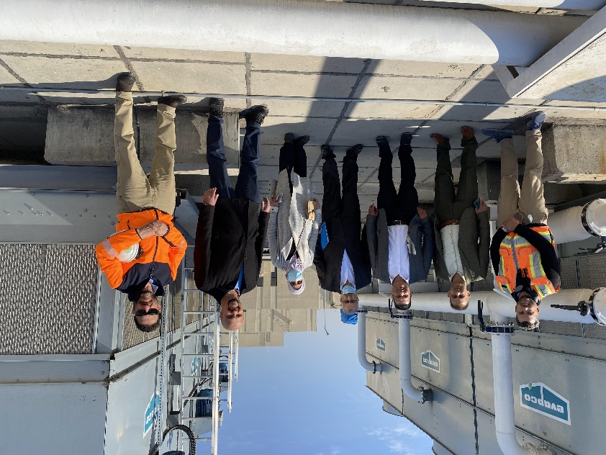
EDUCATIONAL TIKRIT HOSPITAL – 400 BEDS
GREAT TEAM LEADERS ARE TEAMMATES FIRST
ERAM Engineering Consulting Office was established with the aim of raising the standards of professional engineering consulting, through its founder, who has 20 years of experience in the field of design, management, and implementation of projects, and in partnership with a group of highly experienced and competent engineers as a result of intellectual and professional compatibility since starting to work as an engineering group since 2018.
These seasoned leaders are responsible for building and maintaining strong client relationships and for growing capable, reliable teams that improve processes, speed delivery and support all facets of your commercial construction project.
4
www.eramconsultant.com

Slide 6
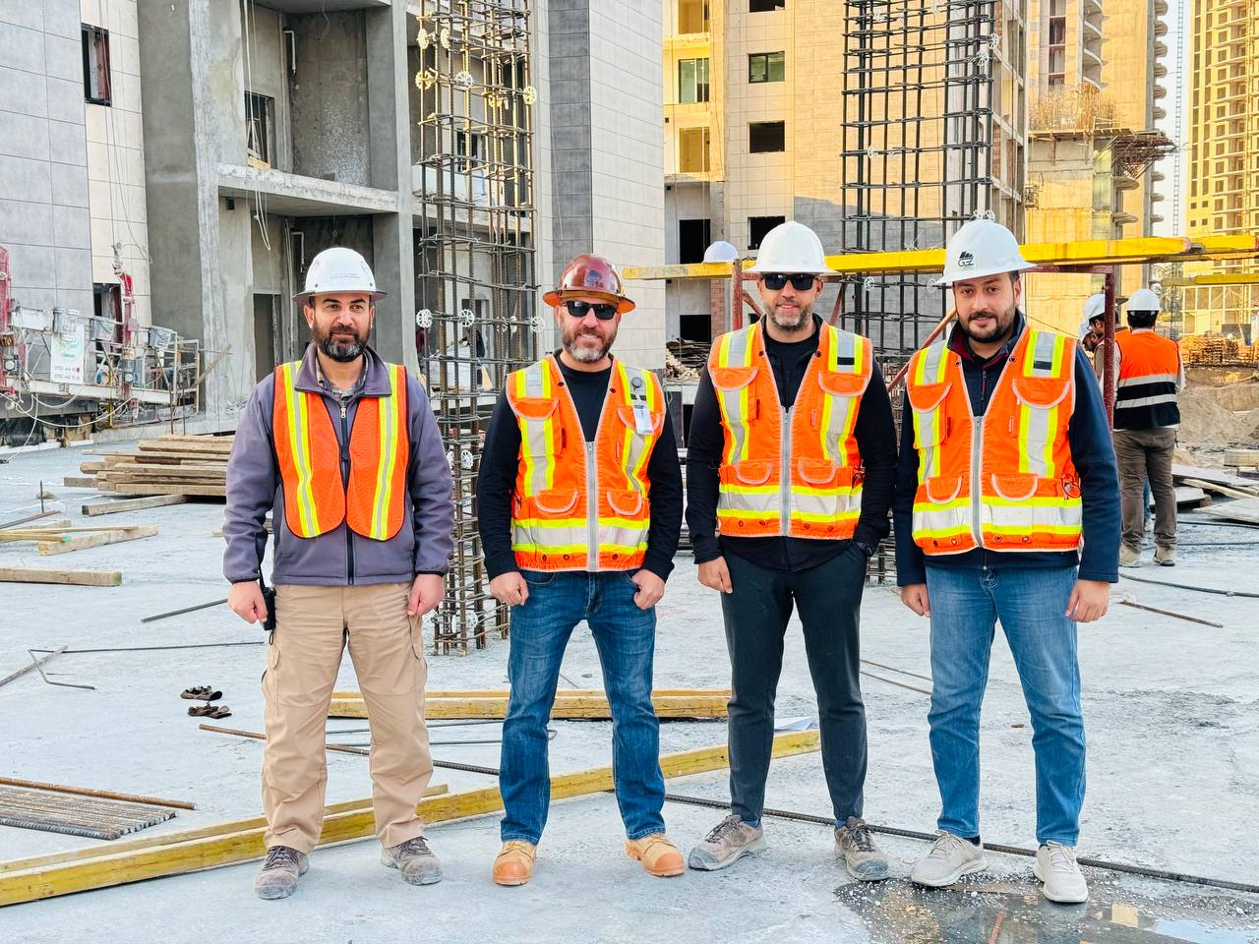
ROYAL CITY PROJECT - BAGHDAD
TEAM
To support this process, with God’s help, the idea of establishing an office with an elite group of competent engineers was implemented as a result of joint work together since 2018 to implement the first joint project, which is the Tikrit Teaching Hospital rehabilitation project, funded by the UNDP, and the management of the Royal City housing project in Baghdad, and the cooperation of the below competencies in making the projects successful.
1- Consultant Civil Engineer Ali Raouf Ali
2- PMP Certified Civil Engineer Haider Mahmoud
3- Consultant Electrical Engineer Fouad Hussien
4- Consultant Mechanical Engineer Abdulaziz Amir
5- Electrical Engineer Tawdad Ali
The ERAM Engineering Consulting Office (ERAM) includes a workforce consisting of engineering, technical and administrative cadres in all specialties who were chosen to form a strong work team capable of preparing studies, designs and managing projects of various types, in addition to the office’s cooperation with a number of consultants, experts and international expertise houses in various fields. Engineering.
5
www.eramconsultant.com

Slide 7
INTRODUCTION
ERAM CONSULTANT BUREAU is a construction, mechanical, Electrical and Plumbing contracting bureau in Iraq specialized in design, build, construct, supply, install, service, upgrade, maintenance of Electro-Mechanical Systems & Networks, Utilities and Equipment. Our scope covers Engineering, Documentation, Submittals Approval, Shop drawings, Coordinating Drawings, Commissioning, Start-Up, As-Built.
To Contract Programs, Project Time Schedules -Complying Consultant Specifications, International Standards & Codes, Safety & Quality Plans.
Our Business activity extends to cover sectors:
Designing
Designing all types of projects
Providing Consultancy for all type of construction works.
Project Management
- Construction project management
- Site supervision
Civil Engineering
- Concrete Forming Works ( Tunnel and Doka ) systems
- All Type of Finishing works
Waterproofing Systems. Liquid & Membrane Systems
Geosynthetic Clay Cover
Concrete Preparation and Coating Systems
Rehabilitation and Concrete Repair
FRP Systems Retrofitting
Soil Stabilization
Reinforcement of the Ground by Injection of Cement Grout
Electrical Engineering
- POWER DISTRIBUTION SYSTEMS
- LIGHTING CONTROL
- POWER GENERATION
- LOW CURRENT SYSTEMS
- INDUSTRIAL PROCESS SERVICES.
Mechanical Engineering
- HVAC Engineering Services
- Duct Manufacturing
- Plumbing Engineering Services
- Fire Fighting engineering services
- Hot & Cold Water Supply System
6
www.eramconsultant.com

Slide 8
Designing and consultancy
Designing and Consultancy for all types of projects
1- Residential Projects
Private houses
Villa’s
Residential complex's project ( Horizontal and high raised buildings).
2- Commercial Buildings
Office buildings
Restaurants & Cafe shops
Malls, Retail and shopping centers
Hotels & Motels
Warehouses
3- Services Buildings and Health Care Facilities
Hospitals
All type for Beauty centers
GYM Facilities
Dental Clinic centers
4- Urban and Landscape Designing Projects
Providing Consultancy for all type of construction works.
7
www.eramconsultant.com

Slide 9
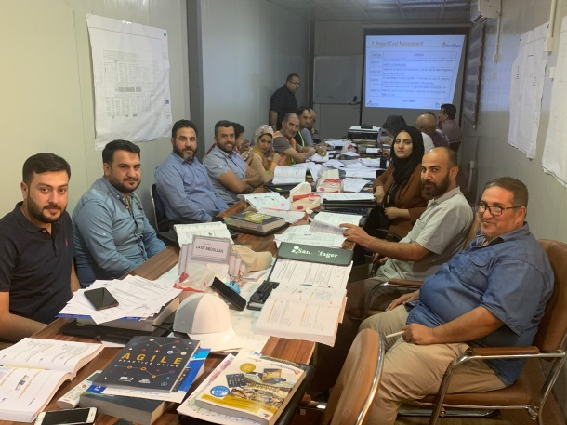
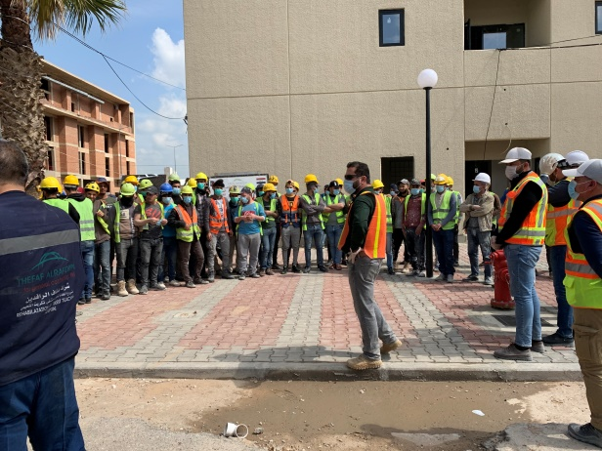
Project Management
When we offer our project management consultancy package to our clients, they know that their project lies in safe hands. from tender preparation and administration to the ﬁnal commissioning and hand over. Our project team will be closely supervising each and every aspect of the project ensuring that our client’s interest is best protected. Our project Management Consultancy services spans the entire project execution phase
Construction Project Management
Site Supervision
CM professional practice includes specific activities.
Management structure of the project management team.
Organizing and leading by implementing project controls
Project daily inspection and supervision.
Design review.
Shop drawing review.
Material submittal approval.
Project specification conformity.
Safety compliance.
8
www.eramconsultant.com

Slide 10
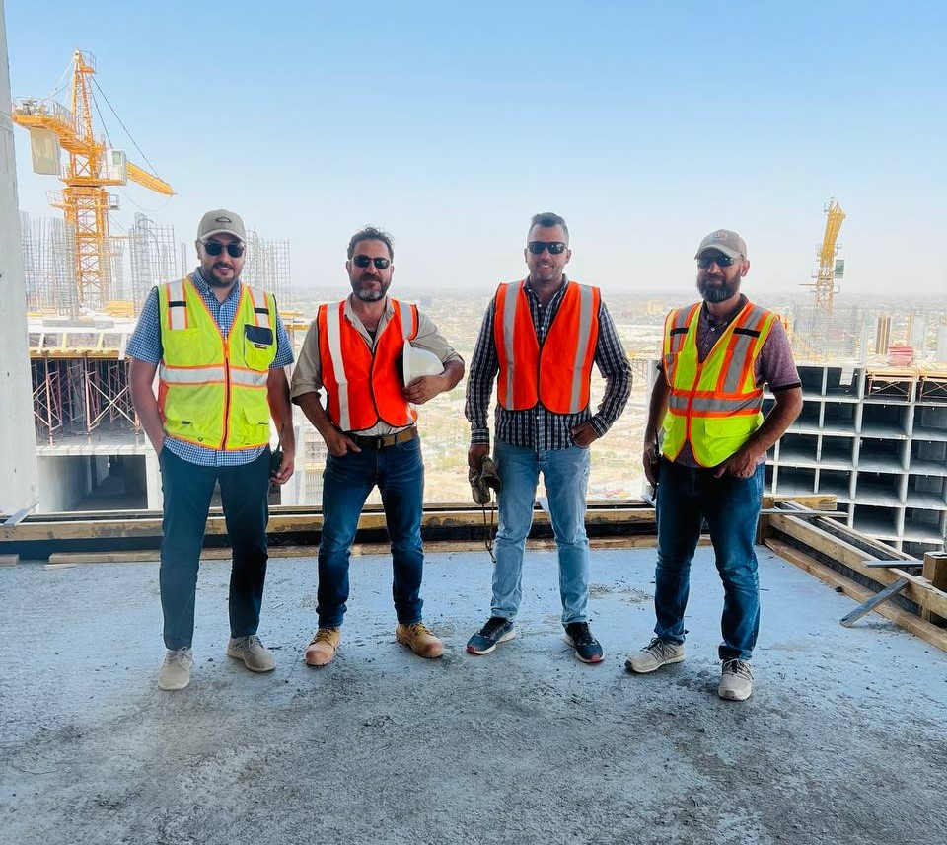
Civil Engineering
ERAM Civil is the Civil Construction arm of ERAM Consultant. Having completed multiple projects in the past and continuing to develop more, ERAM Civil continues to innovate and lead by example on all projects.
ERAM have special teams for all civil and architectural works
9
www.eramconsultant.com

Slide 11
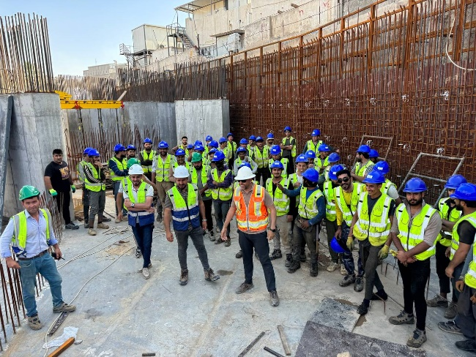
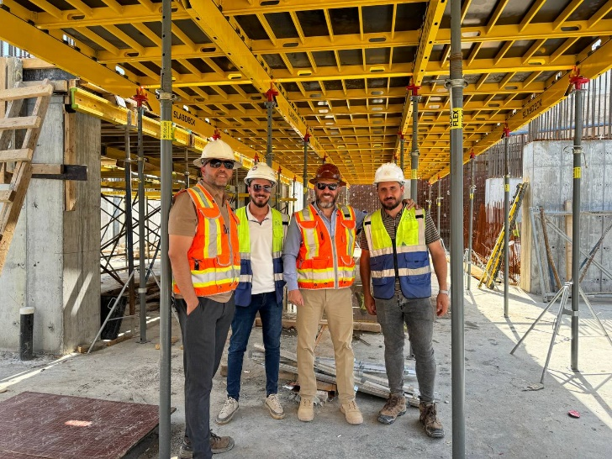
Civil Engineering
ERAM FORM WORK
Why ERAM Formwork
Our commitment to providing the best solutions to our clients and a safe workplace to our employees has seen us successfully deliver projects that have shaped the skyline of IRAQ. ERAM Form’s expertise resides in the quality of work demonstrated in our commercial, healthcare facilities and multi-level residential construction projects. Optimizing the outcome and productivity of every job is our most valued trait, guided by a safety-first culture, wise leadership and innovation.
Our team consists of qualified engineers and skilled labors, the are professionals who are led by highly-experienced management teams with combined of local experts in forming works
Fields of Forming Works
1- Tunnel Formwork
2- Plywood Formwork
3- Panel Deck Systems
4- Multi Forming Systems
10
www.eramconsultant.com

Slide 12
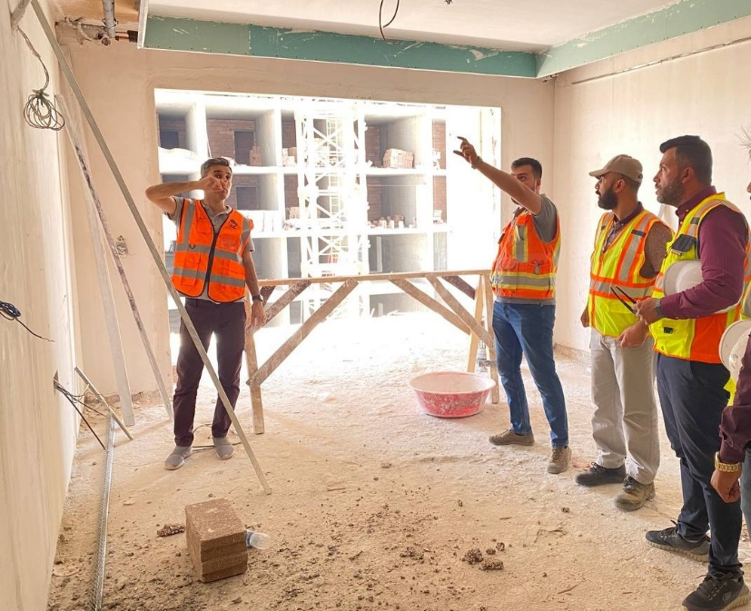
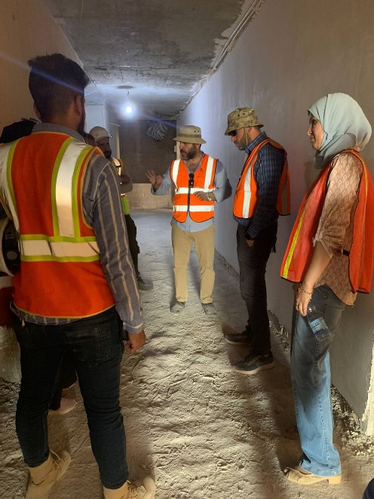
Civil Engineering
FINISHING WORKS
ERAM teams have all capabilities and experiences to implement all type of finishing work.
Management plan and follow up to achieving best products are the keys for ERAM Finishing Works teams
Fields of Finishing Works
1- All Types of Wall Plastering Works
2- Screed Flooring Works
3- All Types of Tiles and Marbels Works
4- All Types of Wall Partition Systems
5- All Types of Suspended Ceiling Systems
11
www.eramconsultant.com

Slide 13
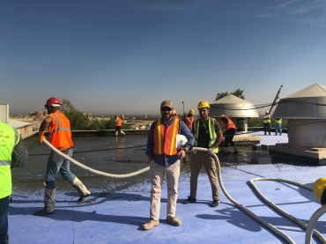
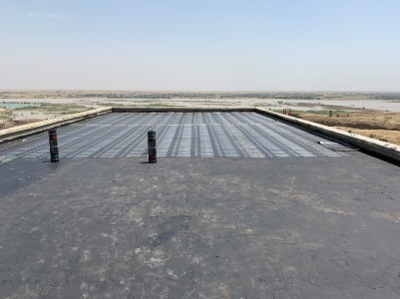
Civil Engineering
Waterproofing Systems
Liquid & Membrane Systems
We conduct new water insulation works and we rehabilitate the insulation in old buildings including all kinds of concrete sloping (foam concrete- Perlite).
ERAM also conduct all kinds of water insulation works (bitumen-PVC-EPDM-…etc.) and all kind of thermal insulation (polystyrene-Polyurethane -Rockwool-Perlite, etc. ) beside sound insulation works and anti-moisture and Fire insulation.
Cementitious Waterproofing
Liquid Waterproofing Membrane
Bituminous Membrane
Bituminous Coating
Polyurethane Liquid Membrane
ERAM It owns a set of equipment and tools all types of waterproofing systems.
Airless Spray Equipment
Foam concrete Equipment.
Cementitious materials Spray Equipment.
12
www.eramconsultant.com

Slide 14
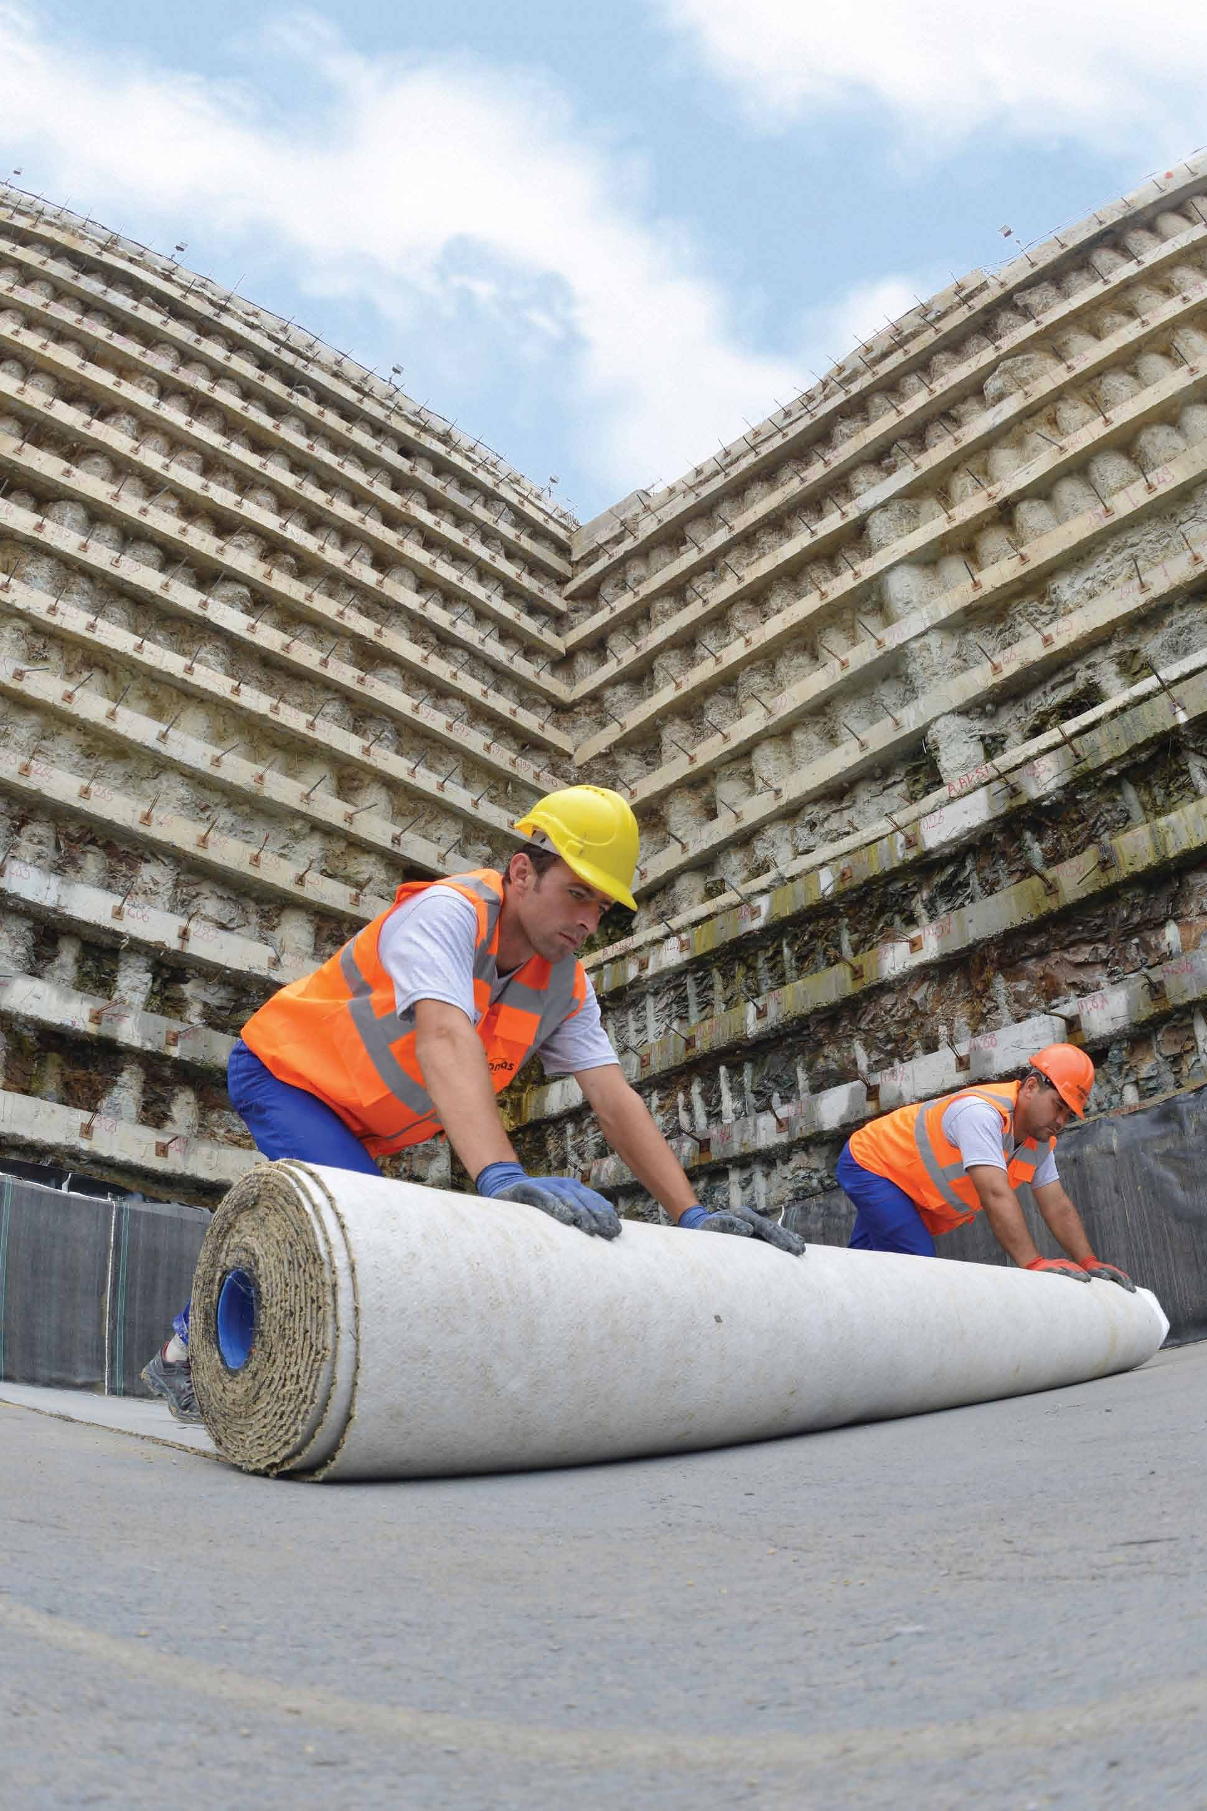
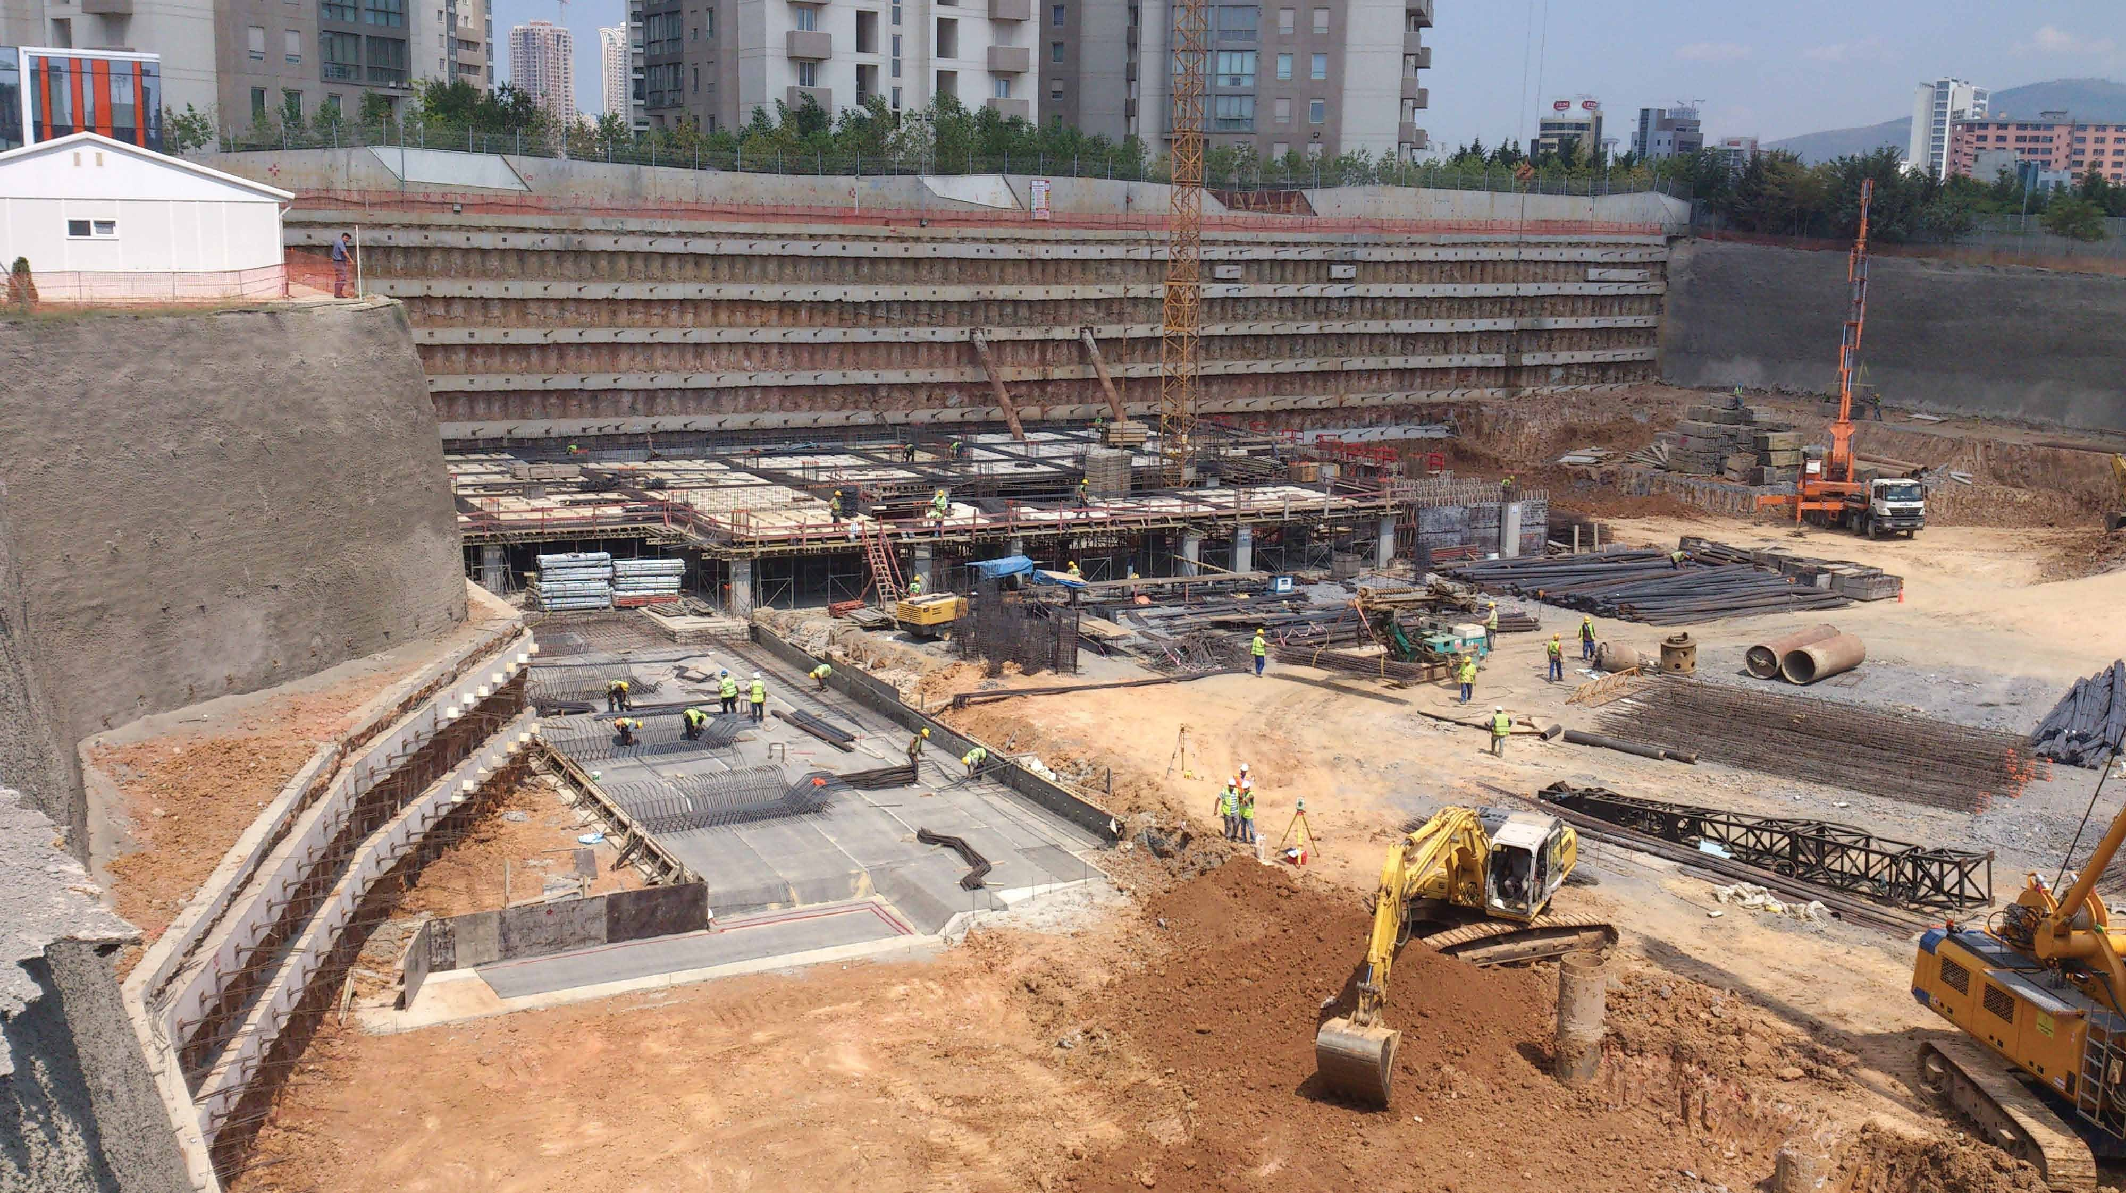
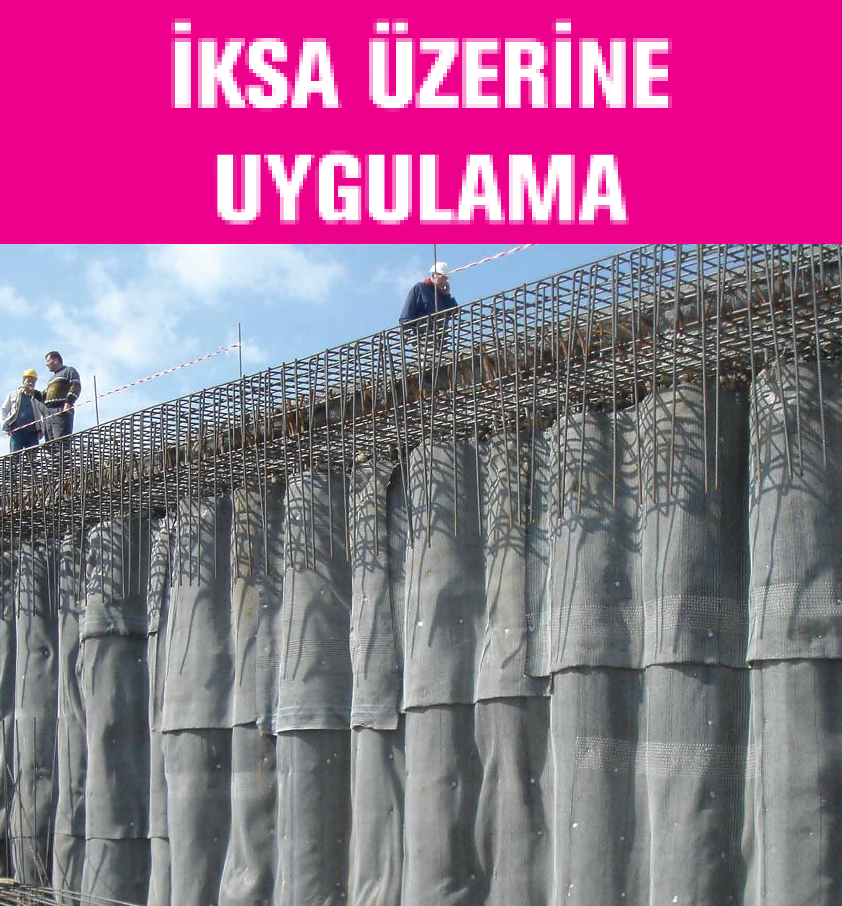
Civil Engineering
Waterproofing Systems
ERAM goals performed many successful projects by using deferent types of technics. We represent Elite brands in this sector .
GEOSYNTHETIC
Clay Cover
The sealing technology of GCL , effectively combines the unique swelling performance of sodium bentonite granules with two high strength geotextiles.
Once GCL is hydrated, it forms an impermeable barrier against liquids, water vapor and gases.
geo-synthetic clay liners (GCL's) are very effective sealing liners for wide variety of environmental projects from landfills to mining areas, lagoons and canals.
GCL is most economical and effective solution for all your specific requirements.
GCL is remarkably higher hydraulic performance when compared to a meter of conventional compacted clay liner or other waterproofing systems. In addition to superior hydraulic performance, GCL effectively overcomes the technical difficulties confronted during installation in compacted clay applications and provides a cost effective solution.
13
www.eramconsultant.com

Slide 15
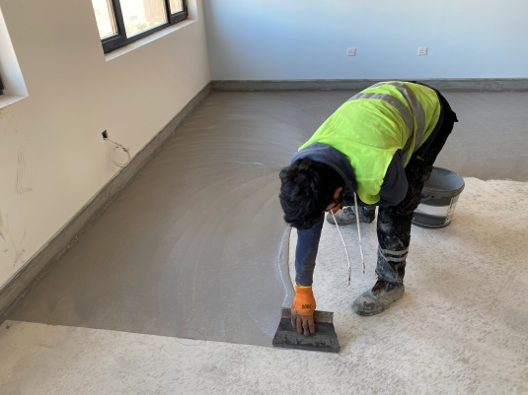
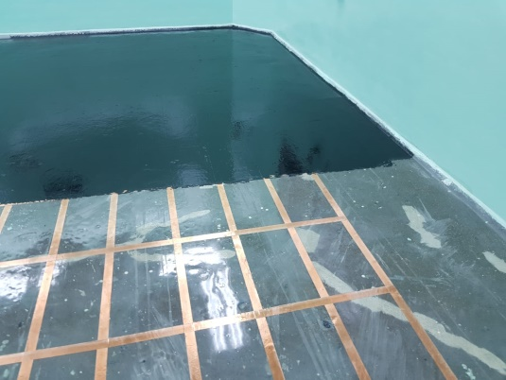
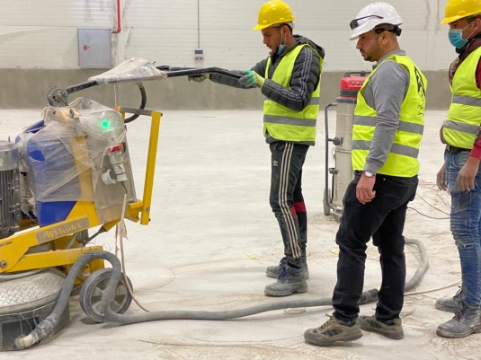
Civil Engineering
Concrete Preparation and Coating Systems
ERAM teams have a premium experience in all types of repairing and coating systems.
Type of Applications
1- All types of Epoxy and Vinyl Coating.
2- Repair work for all construction types. 3- Decorative Coating system. 4- Hospitals Anti – Bacteria & Anti-Static Coating systems. 5- Construction Injection Works. 6- Polished Concrete System ( KLINDEX).
Field of Applications
1- All types of concrete structures.
2- Water tanks cracked structures.
3- Hospitals and industrial areas.
4- Run way repair and joint sealant of rigid pavement.
ERAM owns a set of equipment and tools required to implement the all types of
flooring systems
14
www.eramconsultant.com

Slide 16
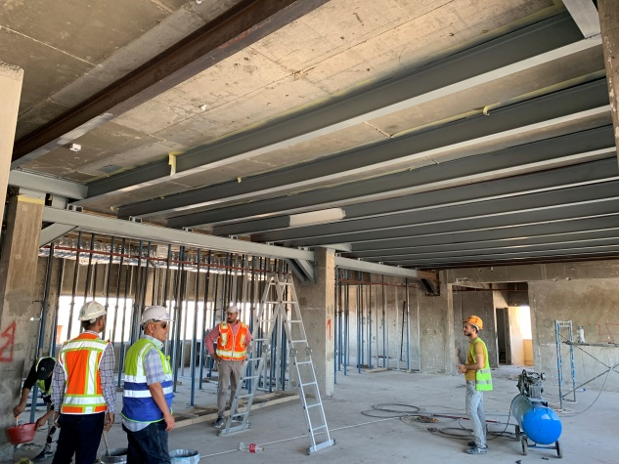
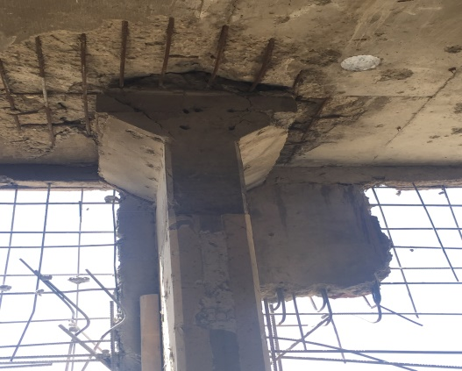
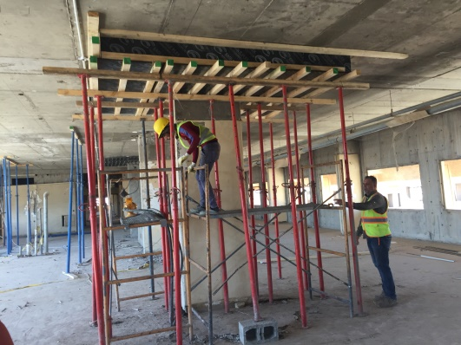
Civil Engineering
Rehabilitation and Concrete Repair
ERAM - We rehabilitate all types of structural elements of ceiling, slabs, bridges, columns and bases etc. that were damaged by leaks and environmental problems caused by cracks and subsidence in building foundations and other reoccurring problems consolidating with the latest equipment such as (carbon ­Fiber Technics).
15
www.eramconsultant.com

Slide 17
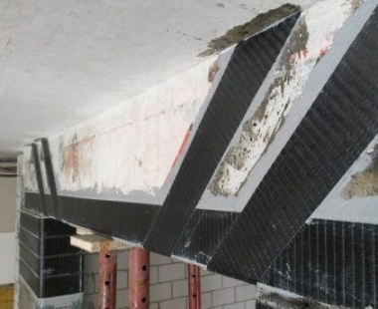
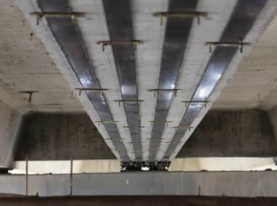
Civil Engineering
Rehabilitation and Concrete Repair
FRP Systems Retrofitting
Retrofitting with RP
FRP repair is a very effective method for retrofitting and strengthening structures.
Fiber-Reinforced Polymer
Fiber reinforced polymer (FRP), also known as fiber reinforced plastics, are two component composite materials used widely in buildings and industry. These materials owe their popularity to their wonderful unique properties such as low weight.
The system of strengthening with FRP is one of the most novel methods for retrofitting buildings, strengthening structures and protective coatings in various industries. Fiber Reinforced Polymer (FRP) or fiber-reinforced-polymer, which nowadays is used extensively in rehabilitation, strengthening and retrofitting of buildings and other concrete and steel structures as well as in the composite industry, consists of two basic components: Fiber and Matrix (Resin). Generally in an effective composite
16
www.eramconsultant.com

Slide 18
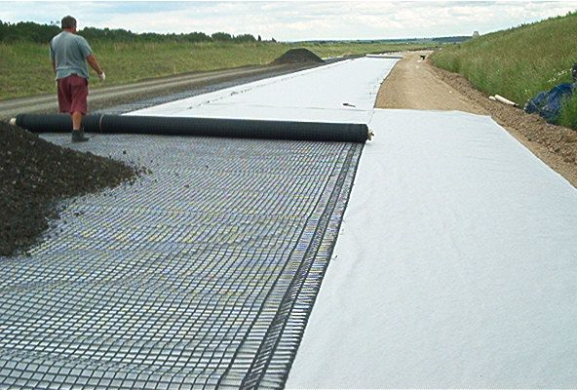
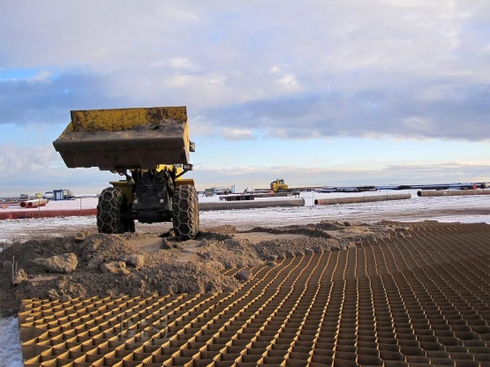
Civil Engineering
Soil Stabilization
The role of soil is crucial for the design and construction of any structure, be it roads, runways or railway tracks.
This is because it acts as the medium for effective load transfer in to the earth.
This implies that a weak soil base will eventually cause settlement of the structure, leading to failure.
Stabilization is the process of improving the engineering properties of the soil before construction. Stabilization is done to improve the strength of the soil and shrink/arrest the swelling potential, thus improving the load bearing capacity and the overall performance of the in-situ soils.
Types of Soil Stabilization
Soil stabilization by mechanical method
Soil Stabilization by Cement
Soil Stabilization by Lime
Soil Stabilization with Bitumen
Chemical Stabilization of Soil
Soil Stabilization by Grouting
Electrical Stabilization of Soils
Soil Stabilization with fly ash
Soil Stabilization by Geotextiles and Fabrics
17
www.eramconsultant.com

Slide 19
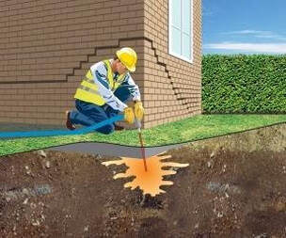
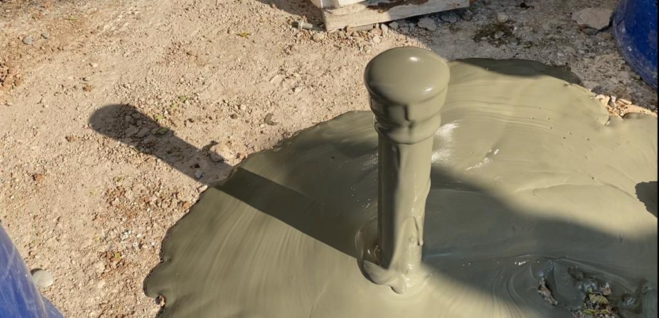
Civil Engineering
Reinforcement of the ground by injection of cement grout
Soil stabilization has become one of the useful solutions to treat the soft soils to achieve the required engineering properties and specification so that structures can be placed safely without undergoing large settlements.
ERAM have all equipment’s and materials to do
these types of application.
ERAM have special drilling tools which can drill up to 4 meters in the ground inside buildings
and out side.
ERAM
Reduce soil subsidence
Improving soil stability
Slope stability
Increase bearing capacity
Reduce vibration
Improve the availability of contaminated soil and sludge
Economic and environmental protection
Low pressure injection (grouting) is a standardized method described by ISO Standards ISO-EN 12715 Execution of special geotechnical work. Grouting. Grouting isn’t a method for the replacement of natural soil like jet grouting. In the grouting method, liquid agent is pumped by a special drilling hole into soil or rocks using pistons or plungers pump. Injected agent fills free area and decreasing water permeability. Therefore the goal of grouting can be described as modification of natural soil by:
filling of soil emptiness (suffusion effect, fractures etc.),
filling of porous canals in soil,
compaction and moving soil grains by the pressure of agent (binder).
18
www.eramconsultant.com

Slide 20
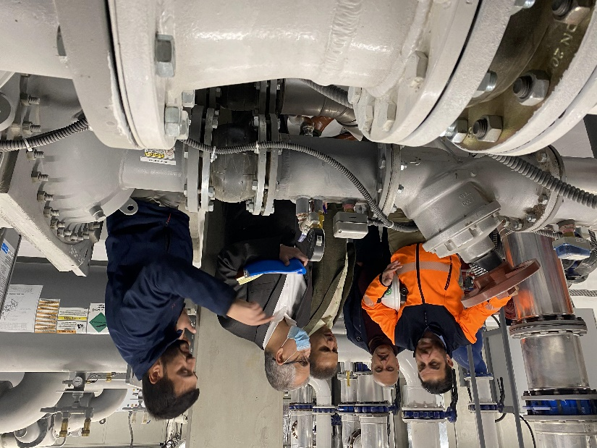
Mechanical Engineering
ERAM capabilities in Construction, Construction Materials application, Mechanical, Electrical & Plumbing are built around providing feasible and economically viable designs. The company is devoted to develop and discover solutions that are a perfect fit for the Client’s objective as well as budgets.
The gamut of services offered by MAEC encompasses heating, ventilation, air conditioning, refrigeration, plumbing, fire protection and utility distribution systems.
Mechanical Systems
HVAC SYSTEM
HOT & COLD WATER SUPPLY SYSTEM
FIRE FIGHTING SYSTEM
MEDICAL GASES SYSTEM
WATER FILTRATION SYSTEM
IRRIGATION SYSTEM
SWIMMING POOL
DRAINAGE
SANITATION
RAIN WATER
SEWAGE TREATMENT
LPG/Fuel SYSTEM
19
www.eramconsultant.com

Slide 21
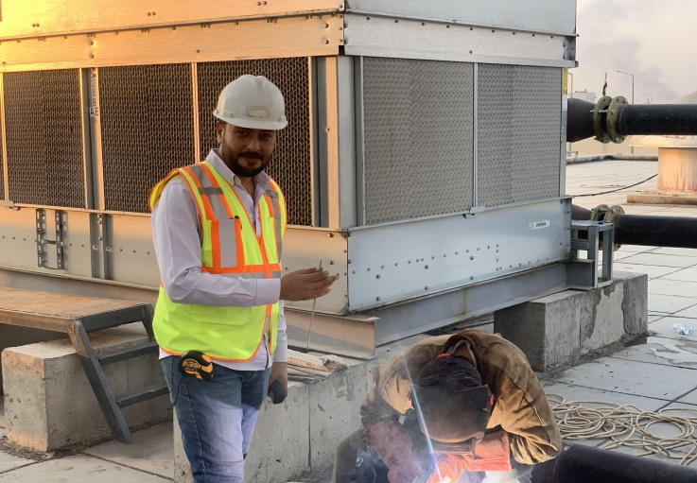
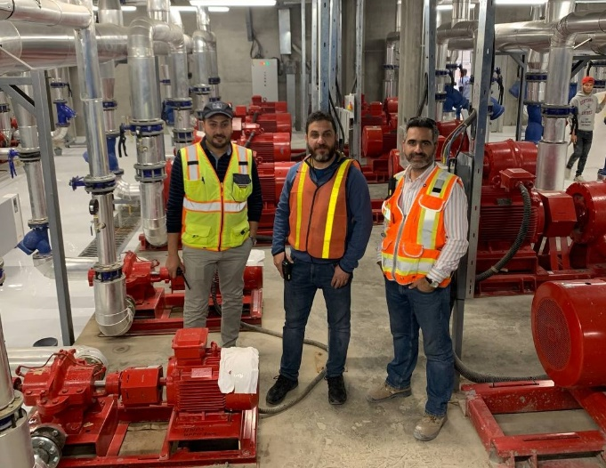
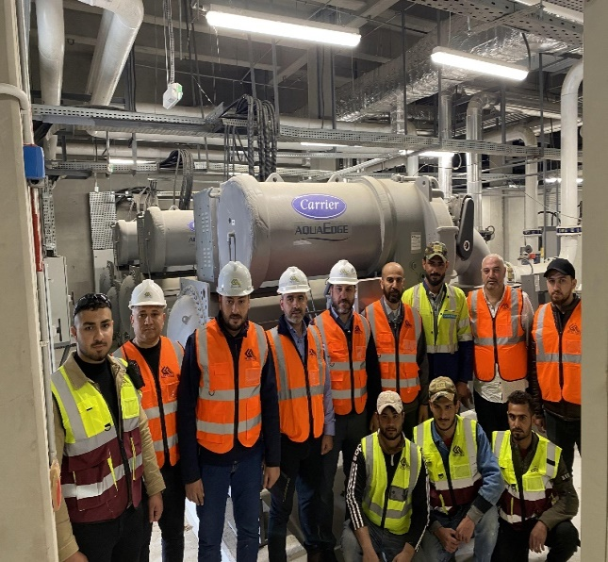
Mechanical Engineering
HVAC ENGINEERING
SERVICES
ERAM is an experienced HVAC specialist.
HVAC - a specialist Company in the Iraq
We provide HVAC (Heating, ventilation
& Air Conditioning) systems including
automated control systems.
MAEC is an experienced HVAC specialist.
HVAC SYSTEM : -
1-Centrifugal Water Cooled Chillers.
2-Air Cooled Chillers.
3-Cooling Towers.
4-Boilers.
5-Chilled and Hot Water Pumps.
6-Pressurizing Units.
7-Dozing Pumps.
8-Air Handling Units.
9-Exhaust Fan.
10-Ducts Works : -
(Galvanized Steel Sheet with Different Gauge & Foam & Stainless Steel & Black Steel).
A-Insulation Ducts.
B-Fire Damper.
C-Volume Damper.
D-Diffusers and Grilles.
11-Split Units.
12-VRV & VRF System.
13-Package units.
20
www.eramconsultant.com

Slide 22
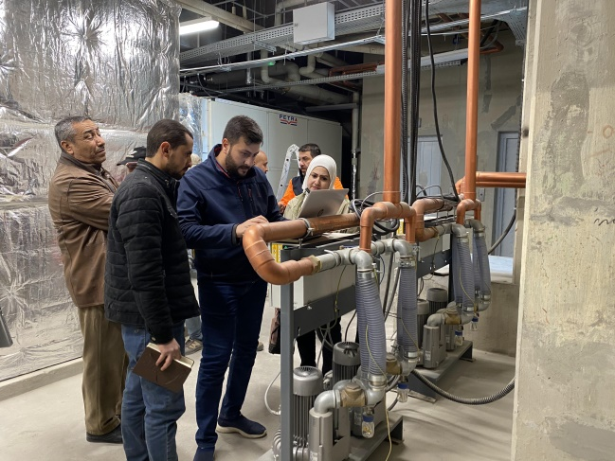
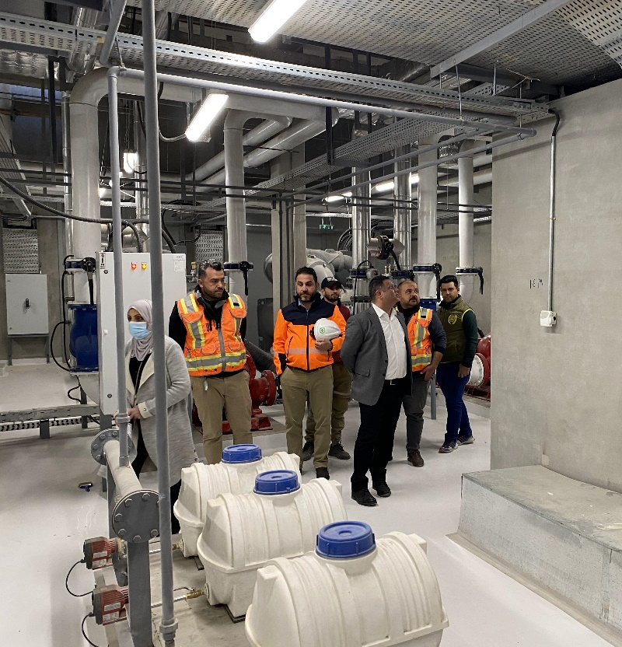
Mechanical Engineering
PLUMBING ENGINEERING SERVICES
Our plumbing services team handles all aspects of plumbing, water supply, drainage, swimming pool filtration systems & fire fighting works.
Our plumbing engineers design , execution and analysis for the required works.
Plumbing systems must accomplish two important functions in buildings. They must provide a constant water supply for occupants, and for all equipment that requires it. At the same time, they must remove wastewater effectively to prevent health hazards. A well-designed plumbing system is necessary for a healthy building interior.
When designing a plumbing system, engineers analyze the water requirements of the building to specify an installation of the right capacity. Undersized piping and fixtures cannot deliver water at the required pressure and flowrate. However, oversized plumbing systems are more expensive, without offering any benefits in return.
21
www.eramconsultant.com

Slide 23
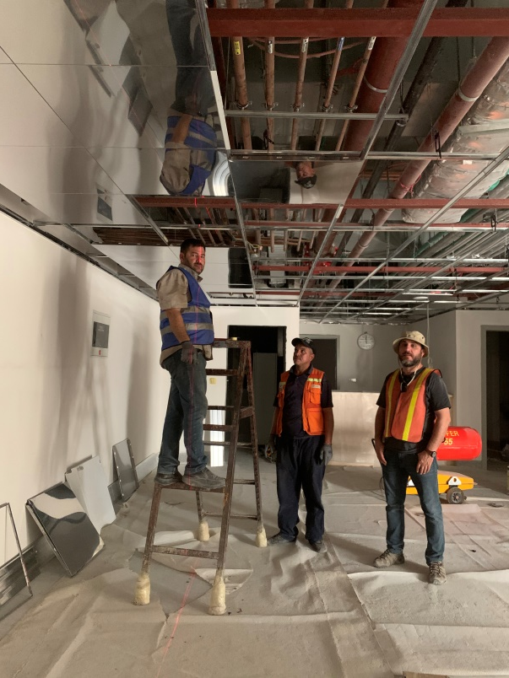
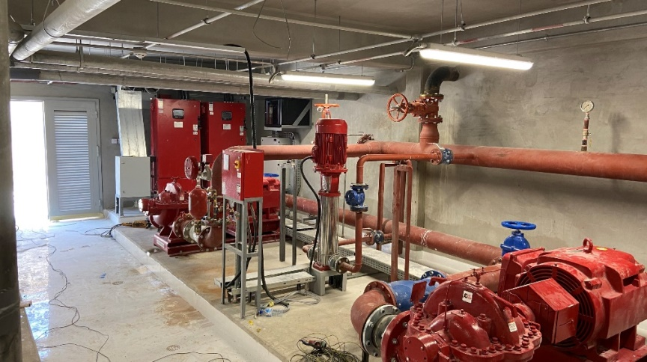
Mechanical Engineering
FIRE FIGHTING ENGINEERING SERVICES
Fire engineering is the application of the principles of science and engineering to protect people, property, and their environments from the harmful and destructive effects of fire and smoke, and it includes fire protection engineering that we focus on detecting, suppressing and mitigating fires, and also including safety engineering that focuses on human behavior and their defense and evacuation from fire.
• Fire detection - fire alarm devices and systems.
• Active fire protection - fire suppression systems.
• Smoke control and management.
• emergency exits. Fire protection program.
• human behavior during a fire.
• Risk analysis, including economic factors.
Fire Fighting System: -
1-Fire Fighting Pumps
2-Alarm Check Valves
3-Preaction Check Valves Assembly
4-Zone Control Valves
5-Fire Hose reel cabinet
6-Sprinklers
7-Fire Extinguishers (ABS,CO2,Foam)
8-Landing Valves
9-Siamese Connection Assembly (4way,3way,2way)
10-Clean Agent Fire system (FM-200)
11-OS&Y Valves
22
www.eramconsultant.com

Slide 24
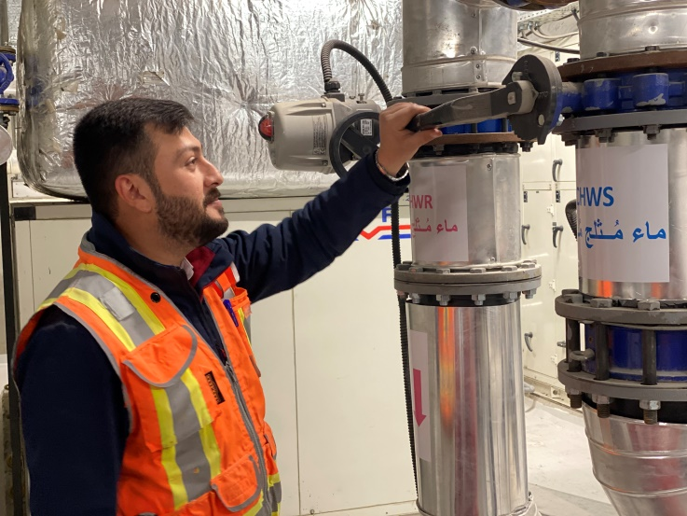
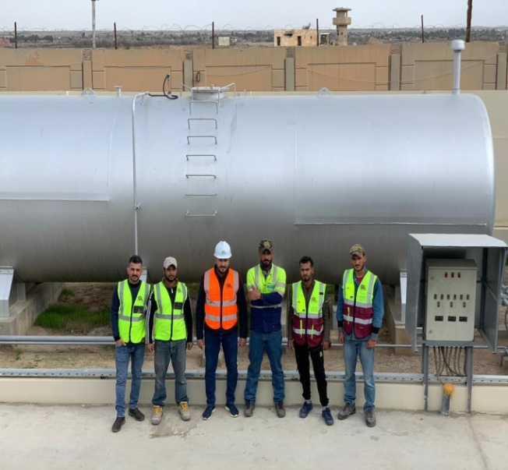
Mechanical Engineering
HOT & COLD WATER SUPPLY SYSTEM: -
1-Main Water Tank.
2-Booster Pumps
3-Softener System
4-Ro System
5-Electric Water Heater or Boiler
6-Pressed Steel Tank or GRP Tank
FUEL and LPG MEP DESIGN &
INSTALLATION WORKS
We are able to undertake complex MEP
design and build projects at any level,
up to major residential, commercial and
industrial sector projects with high.
We offer a full MEP design and build
service for our clients using the most
innovative and energy efficient products
to provide state-of-the-art installations
which save both time and cost throughout.
23
www.eramconsultant.com

Slide 25
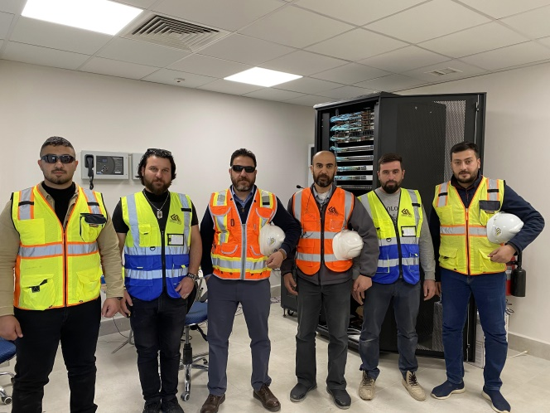
ELECTRICAL
ENGINEERING
SERVICES
Electrical Works
ــــــــــــــــــــــــــــــــــــــ
POWER DISTRIBUTION SYSTEMS
LIGHTING CONTROL
POWER GENERATION
LOW CURRENT SYSTEMS:
- TELEPHONE & DATA SYSTEMS
- HOME AUTOMATION
- MATV SYSTEMS
- CCTV
- FIRE DETECTION & ALARMS
- ACCESS CONTROL SYSTEMS
- AUDIO / VIDEO INTERCOM SYSTEMS
INDUSTRIAL PROCESS SERVICES.
We offer a complete service from
feasibility study to conceptual design
and installation. We offer electrical and
engineering service.
We have preferred contractor status for
many of the regions high profile clients
where we offer longstanding relationships
built around our ability to provide
innovative solutions.
The availability of well-known Electrical Products and high quality Equipment, is the key point to a reliable, efficient and economic Electrical Distribution sector that will last for long time and help developing Iraqi Infrastructure.
We, at ERAM for electrical facilities are working hard to provide the Iraqi market with highest quality products
24
www.eramconsultant.com

Slide 26
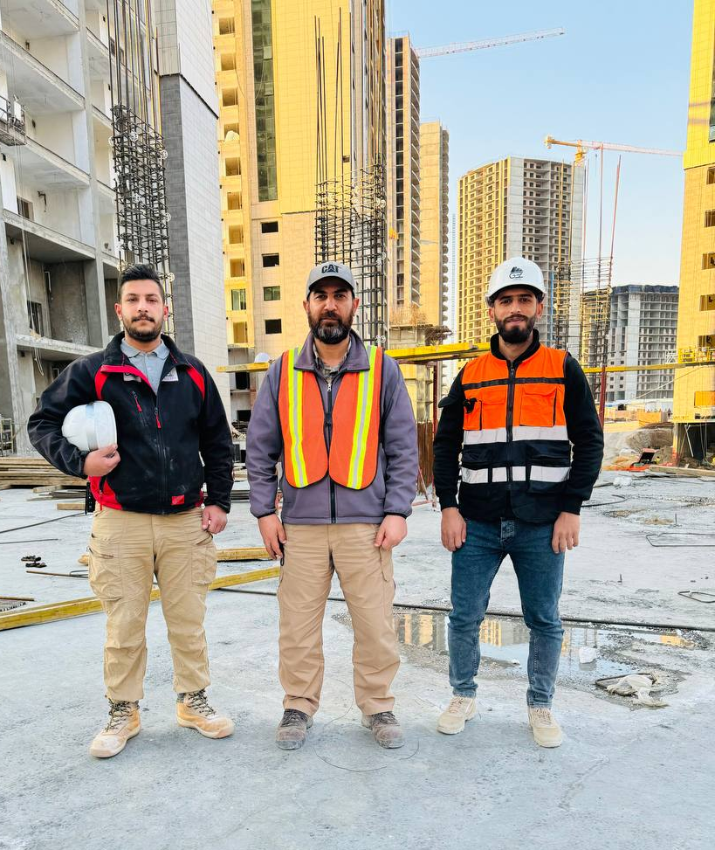
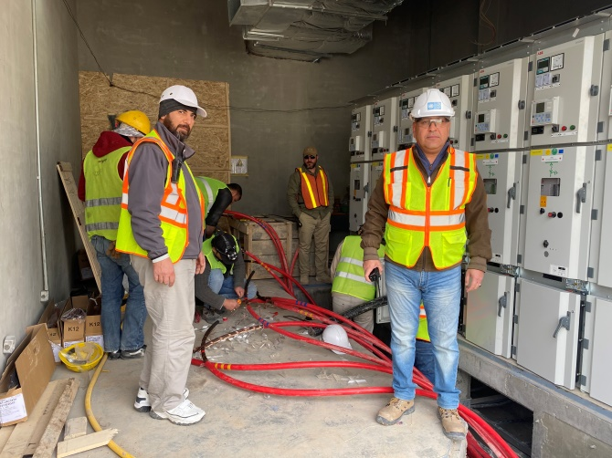
ELECTRICAL
ENGINEERING
SERVICES
SECTORS OF WORK
Residential
1- High Raised Residential Housing Projects.
2- Horizontal Residential Housing Projects.
3- Private Housing Projects.
Commercial
This sector requires electricians to handle more complex and larger-scale systems compared to residential work such as.
1- Malls and Shopping Centers.
2- Offices and Business centers.
3- Retail Offices.
Industrial
This sector is perhaps the most demanding, as it involves electrical work in large-scale manufacturing plants, refineries, and other industrial facilities. ERAM in this field have extensive knowledge of industrial machinery and control systems.
25
www.eramconsultant.com

Slide 27
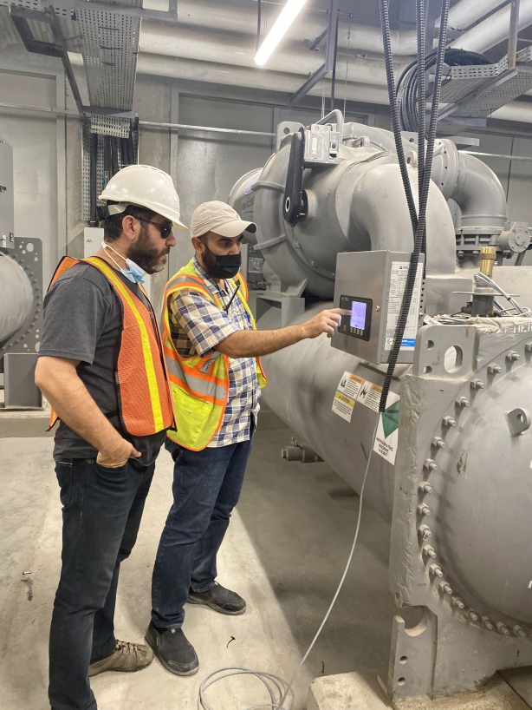
BMS
ELECTRICAL
ENGINEERING
SERVICES
INTEGRATED BUILDING MANAMGEMENT SYSTEMS
Depending on the field of activity, comfort-control needs, electro-mechanical systems of the facilities, BMS system aims to control heating, cooling, ventilation, water supply, lighting, such as mechanical / electrical systems by minimizing human factor, saving on operating costs and providing full control.
Project design and implementation
When you apply to our company, the following works are done to apply the most appropriate system for your plant;
The current electro-mechanical system at your plant is inspected and the demands for automation are determined
The need for integration with other systems in the building automation system such as CCTV, fire alarm, card access, elevator, industrial automation, etc. and its level is determined.
Automation scenarios are created.
When the solution is decided, application projects are prepared, engineering, programming, graphic design, assembly and programming works are completed and training personnel are trained your staff and delivered to the system.
In the initial phase, our engineers supervise the operation of the system, complete the system operators' training deficiencies and perform minor software revisions if necessary.
After your systems are activated, our technical service teams are at your command for your maintenance and service requirements.
26
www.eramconsultant.com

Slide 28
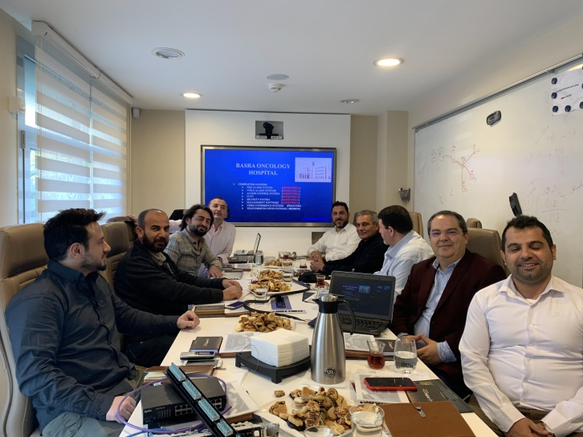
ELECTRICAL
ENGINEERING
SERVICES
Why do we use the building automation system?
Establishment of comfort conditions in controlled areas like zone temperature, humidity, light intensity, air quality, usage water temperature adjustment etc.
Energy Saving: Automatic adjustment of water-air temperature, light intensity, on-off times, calculation of energy consumption
Routine Operation Controls: Creation of daily, weekly, hourly device on-off programs, ensuring the equal wear of the devices by sequential operation,
Preventive Maintenance and System Continuity: Monitoring the life of consumable and spare parts of electromechanical systems, keeping minimum spare parts in stocks, writing work orders in case of failure, detection of frequently defective systems
Elimination of human error and reduction of staff cost: Reduction of errors, unnecessary energy consumption and labor, efficient use of resources with minimum human intervention
The systems which are controlled
Boilers and heating systems
Chillers
Air handling units (AHUs)
Exhaust, supply and pressurization fans
Pumps
Heat exchangers
Mechanical equipment (Fan Coil, VRV, VAV etc.)
Water storage and supply systems, elevators, generators, compressors, water treatment, package devices
27
www.eramconsultant.com

Slide 29
PARTNERS
ERAM signed several MOU’s with several international brands to reinforcing the abilities of ERAM in our beloved country IRAQ.
These partnerships and MOU’s allowed ERAM to hiring the national capabilities and youth brains.
28
www.eramconsultant.com

Slide 30
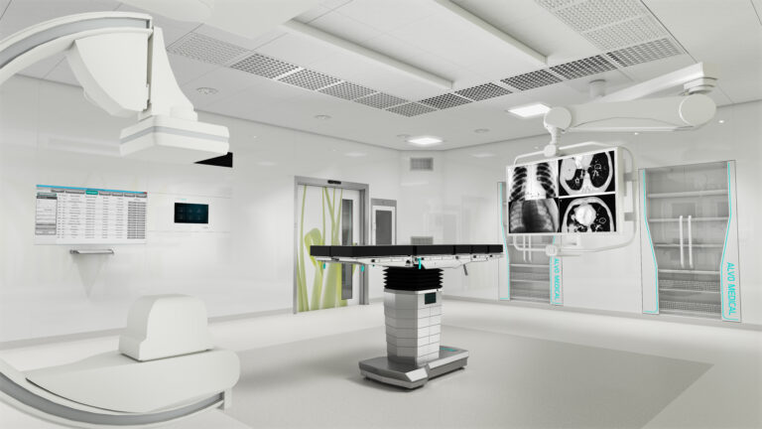
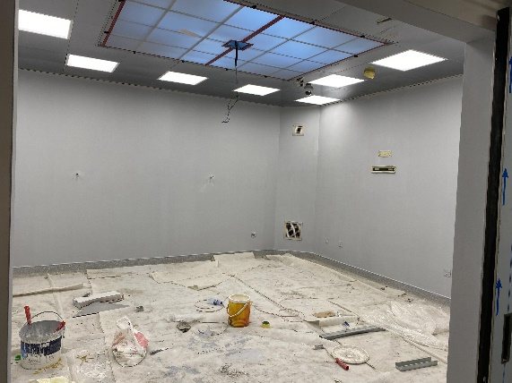
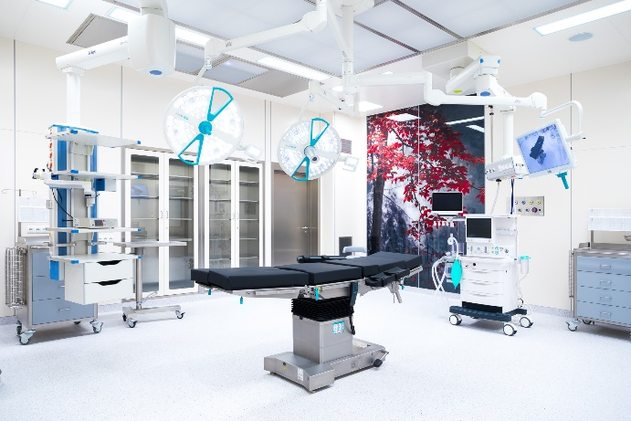
CLEAN ROOM SYSTEMS
HOSPITALS & HEALTH CARE CENTERS
Modular operating rooms
Modular technology allows you to quickly implement scalable solutions in medical facilities, which is difficult with standard construction and finishing technology.
In addition to faster project completion, prefabricated off-site modules may effectively improve workflow and safety during assembly, reducing the number of skilled workers required on site.
Servicies
Designing
Consultancy
Supply and Installation
Maintenance
29
www.eramconsultant.com

Slide 31
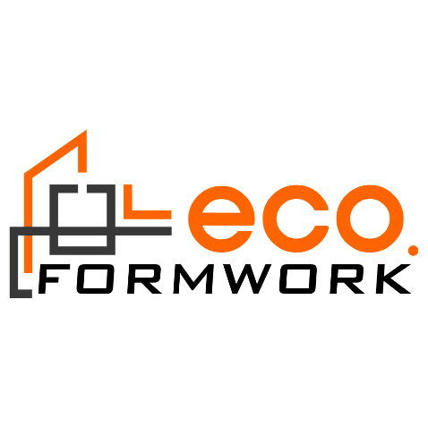
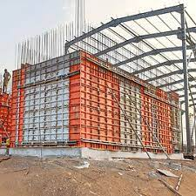
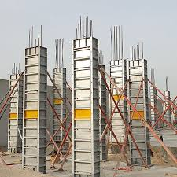
ERAM FORMWORK SOLUTIONS
ECO FORMWORK – DUBAI & ERAM Both signed MOU for all IRAQ projects.
FORMWORK SYSTEMS
1. Walls ECO System 2. Retaining Wall ECO System 3. Core Wall ECO System 4. Round Columns ECO System 5. The Panel and Beam ECO System 6. The Table ECO System 7. The Tunnel ECO System 8. Modular ECO System (Precast Roam) 9. Cast Walls & Slab ECO System 10. Water Tank ECO System 11. Footing ECO System 12. Staircase ECO System 13. Platform ECO System 14. Formwork Precast ECO System
30
www.eramconsultant.com

Slide 32
CONSTRUCTION CHEMICAL PRODUCTS
CEO representing DCP company and he is the exclusive destributer for Kirkuk.
DCP supporting ERAM for all projects.
Product categories
Concrete Admixtures
Surface Treatments
Grouts & Anchors
Flooring Systems
Protective Coatings
Sealants & Joints
31
www.eramconsultant.com

Slide 33
PRODUCTS AND MATERIALS
ERAM doors is a brand of quality doors manufactured in a factory which ERAM is a share holder.
Doors manufactured to fit projects need ( Quality, Price and commitment).
ERAM offering complete services ( designing, manufacturing, supplying and installation).
Our expert team owning 20 years of experiences in manufacturing all types of wooden doors and decoration.
32
www.eramconsultant.com

Slide 34
PRODUCTS AND MATERIALS
ERAM CONSULTATNT
Established a good partnership with many global brands to support project.
As a soul partnership and distributor for those brands increased the strength of ERAM to provide all technical solution depending on client’s need and to fit projects requirements
1- Civil Engineering
2- Mechanical Engineering
3- Electrical Engineering
33
www.eramconsultant.com

Slide 36
Head Office: Baghdad – Hai Al Jamiaa
North Office: Erbil – English Village
Mobile:- 00964 770 278 4700
00964 770 373 9686
00964 781 538 6026
00964 770 953 3385
info@eramconsultant.com
www.eramconsultant.com
www.eram.com.iq

